Slide 1
Moored observations of the Deep Western Boundary Current in the NW Atlantic: 2004-2014
Dr. John M. Toole
Woods Hole Oceanographic Institution
Woods Hole, MA, USA

Slide 2
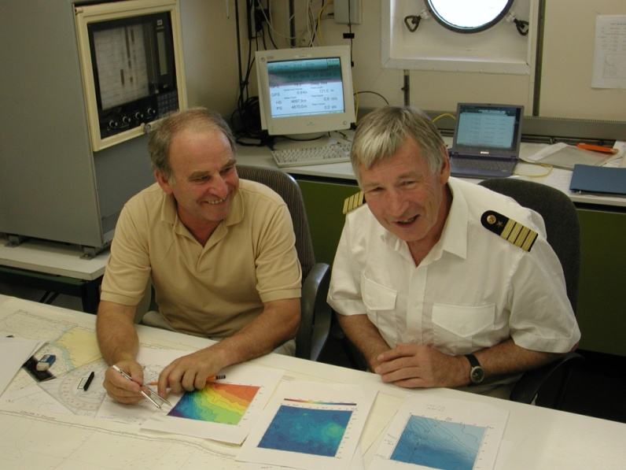
In Memory of Friedrich A. Schott
One of the most influential and productive physical oceanographers.
1964 PhD, University Kiel
1969-1974, Assistant Prof
1974-1978, APL Prof.
1978-1987 Professor at RSMAS Miami
1987-2004 Professor at IfM Kiel
*9. 4. 1939 †30. 4. 2008

Slide 3
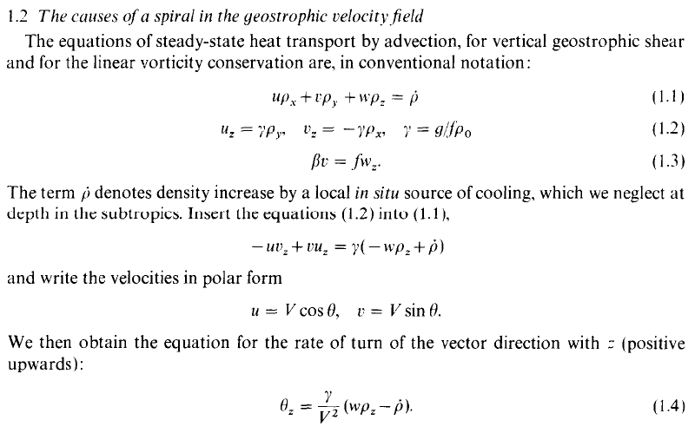
The ß-spiral method for determining absolute velocities from hydrographic measurements
Schott and Stommel 1978
Notes:
During the 70s Fritz developed together with Henry Stommel from Woods Hole the beta spiral method for determining absolute velocities from hydrographic measurements. These calculations showing the rotation of the geostrophic velocity vector with depth on beta plane represents the textbook knowledge of today.

Slide 4
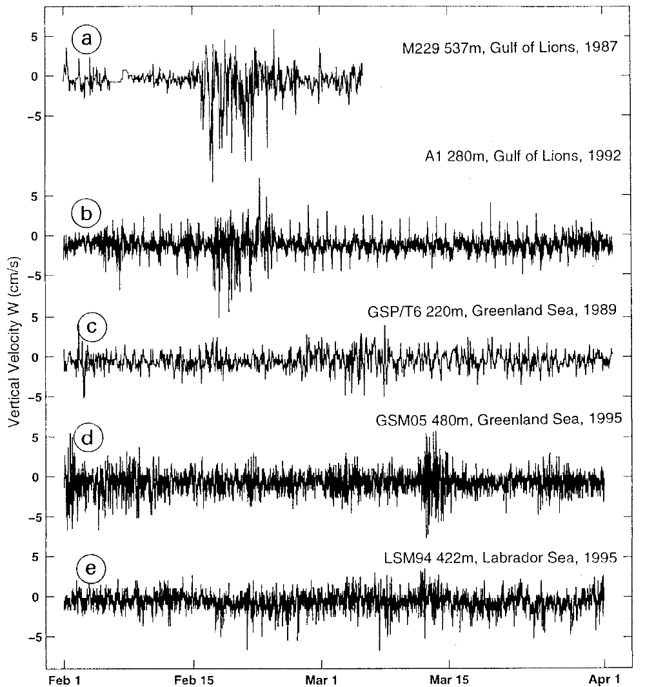
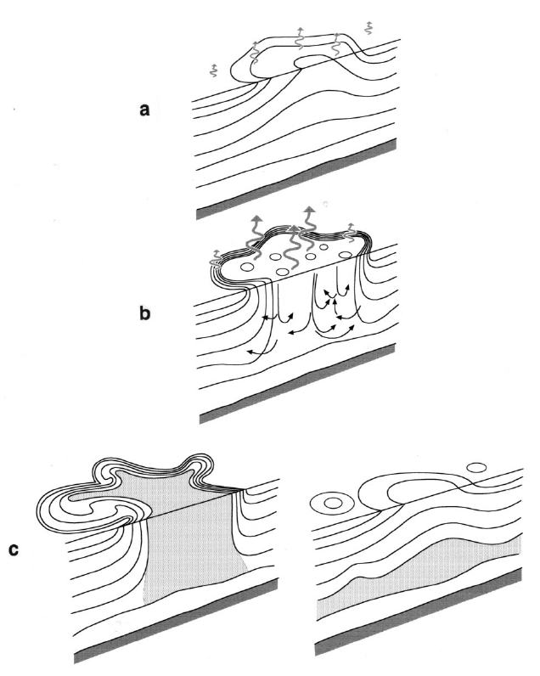
Open-Ocean Convection
First ADCP measurements of vertical velocities in convective regimes:
Gulf of Lions, Greenland Sea, Labrador Sea.
Marshall and Schott 1999
Notes:
But, Fritz was not only interested in the tropical Oceans. In the late 1980s, Fritz became interested in open-ocean convection. This process, which occurs mainly in high latitudes, is characterized by an intense heat loss to the atmosphere. Measurements of vertical velocity and hydrography—carried out with moored instruments during active convection in the Gulf of Lions, the Greenland Sea, and the Labrador Sea—represent the observational basis of his fundamental work regarding open-ocean convection, and those measurements resulted in a landmark paper by presenting observational and theoretical perspectives.

Slide 5
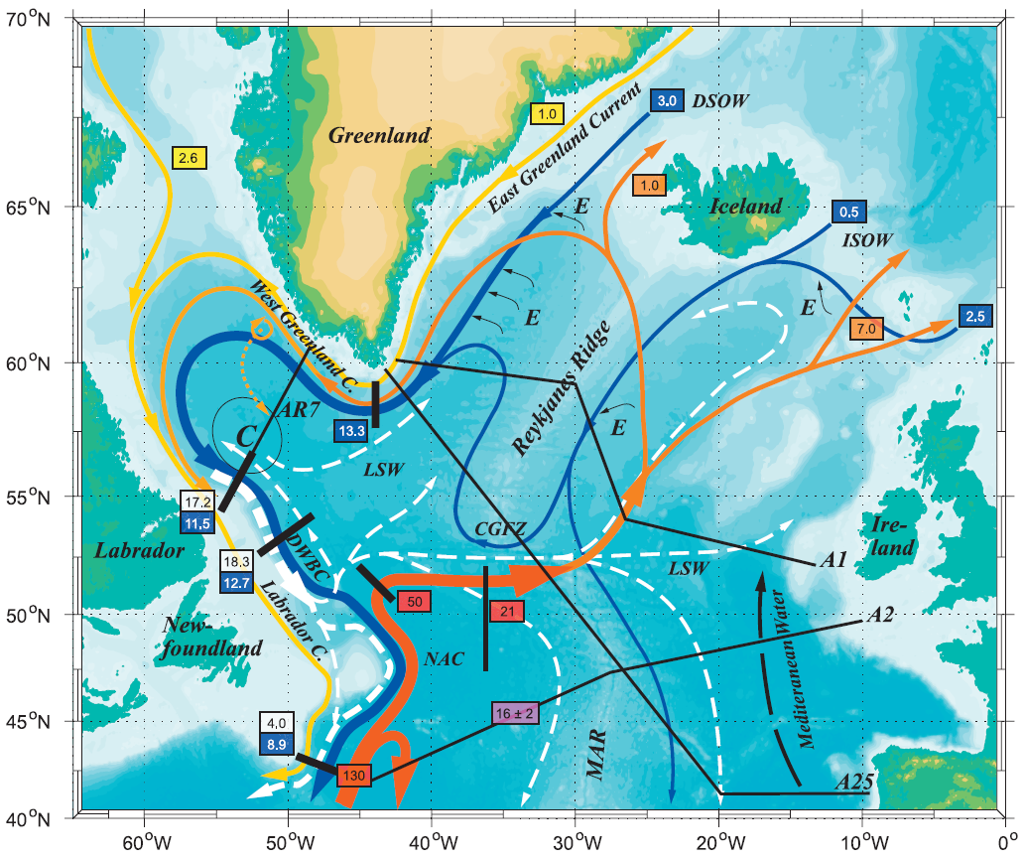
Dynamics of Thermohaline Circulation
Initiator and
driving force behind the
collaborative
research project, funded by the German
Research Foundation from 1996 to 2006.
Notes:
Fritz was the initiator and driving force behind the Dynamics of the Thermohaline Circulation Variability collaborative research project, funded by the German Research Foundation from 1996 to 2006. Within that project, he and his colleagues made major contributions to our understanding of the sinking of cold, dense waters in the northern North Atlantic, a process critical for deep-ocean circulation as well as for the role played by the Gulf Stream and Deep Western Boundary Current system for climate.

Slide 6
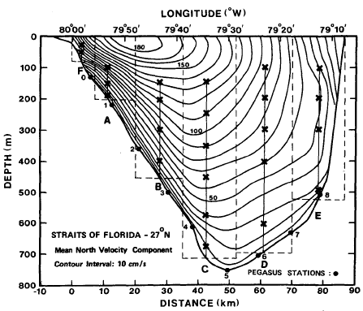
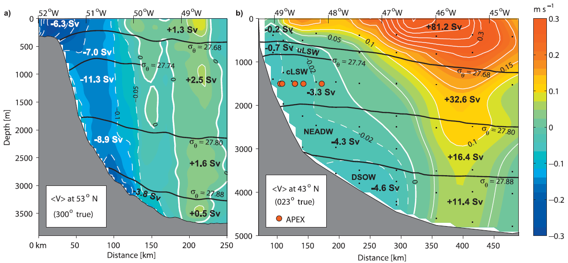
North Atlantic Western Boundary Currents
Moored array observations:
27°N – Florida Current, 1982-1985
53°N – Deep Labrador Current, since 1997
43°N – DWBC, 1999- 2005
Notes:
Particularly strong currents as the Western Boundary Currents were among the main topics of Fritz research. This fact lead to the special session that will be held during the next EGU in Vienna entitled “Strong Ocean Currents: Honoring the science of Fritz Schott” organized by Martin Visbeck, Bill Johns and Jay McCreary.
Here are figures from his observational results regarding the Florida current, the deep Labrador Current and the DWBC off the Grand Banks. The subpolar measurements especially were aimed to identify long-term changes associated with MOC changes, but they show even when including more recent measurements that the western boundary current system still does not show significant long-term changes.

Slide 7
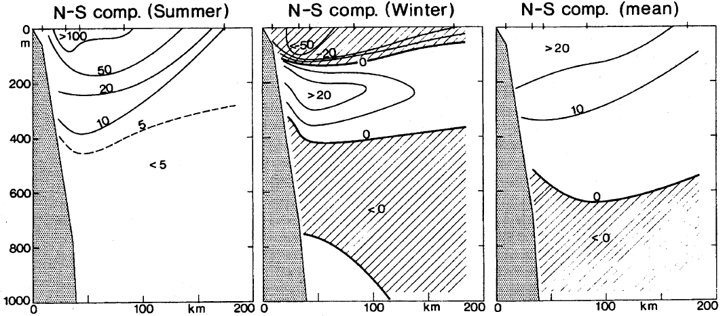
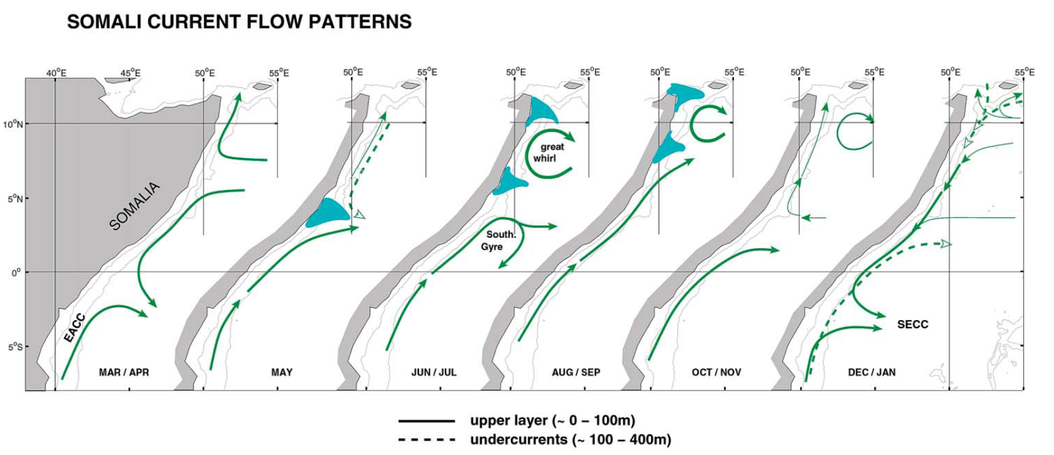
Somali Current Flow Pattern
High-quality, hydrographic surveys and the first long-term direct measurement
of ocean currents from moored arrays.
Schott et al. 1990
Schott and McCreary 2001
Notes:
Much of Fritz research was devoted to studying the dynamics of tropical oceans with their intense and highly variable current systems. Particularly the Indian Ocean remained close the Fritz’s heart. With the first long-term current measurements by at that time newly developed ADCPs he discovered the seasonal variability of the Somali current at depth and draw the first comprehensive current maps of the region.
Flow reversal at the surface
Development of an subsurface undercurrent during the winter monsoon

Slide 8
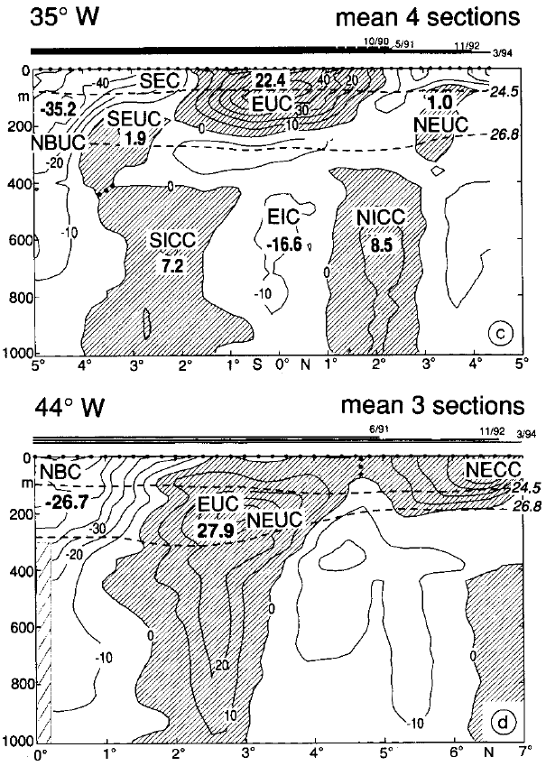
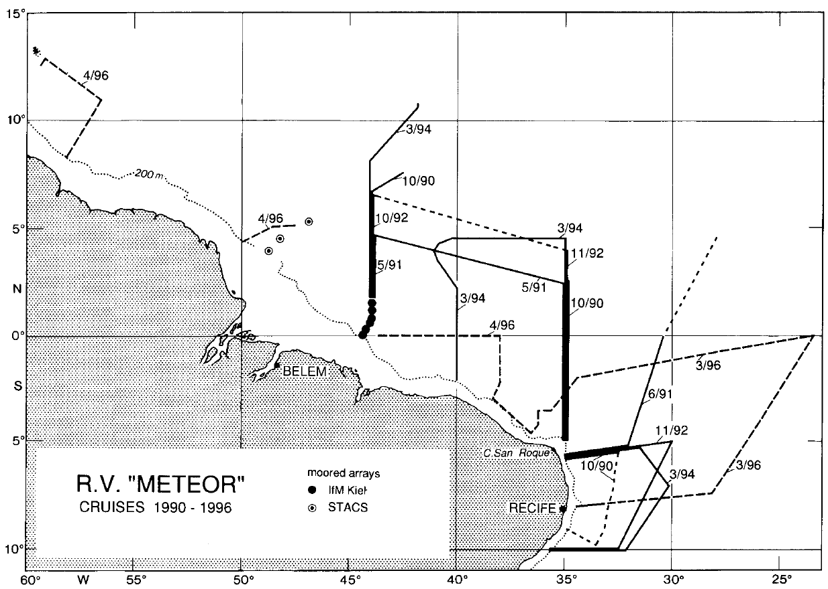
Tropical Atlantic Circulation
R.V. METEOR cruises 1990 - 1996
Notes:
During WOCE and CLIVAR, were Fritz served as a member of the scientific steering committees, Fritz research focused on the western boundary current system in the tropical Atlantic. With several research cruises during the 90s, he were able to describe the mean flow field in the western equatorial Atlantic.

Slide 9
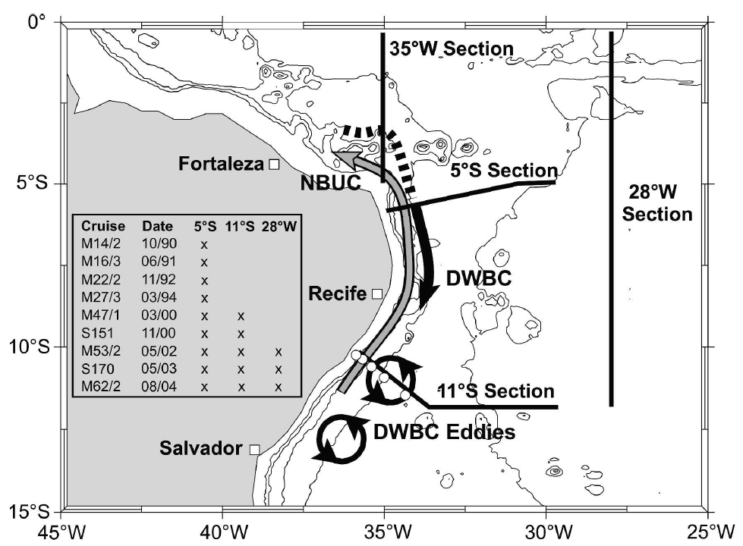
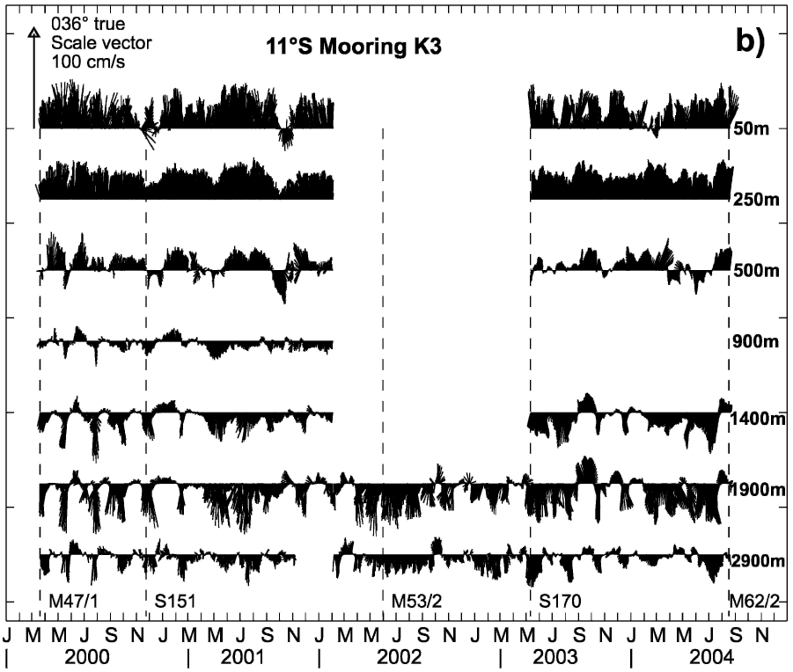
Tropical Atlantic Circulation
Moored array:
11°S, NBUC, DWBC, 2000 – 2004
Schott et al. 2005
Notes:
Later starting in 2000, a mooring array at 10°S aimed at observing the northward warmwater flow within the NBUC and the southward coldwater flow within the DWBC was maintained for several years. These measurements that set benchmarks for validating numerical models showed no long-term changes but high variability on intraseasonal time scale particularly the break-up of the Atlantic Deep Western Boundary Current into eddies at 8°S.

Slide 10
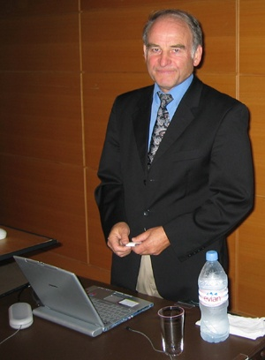
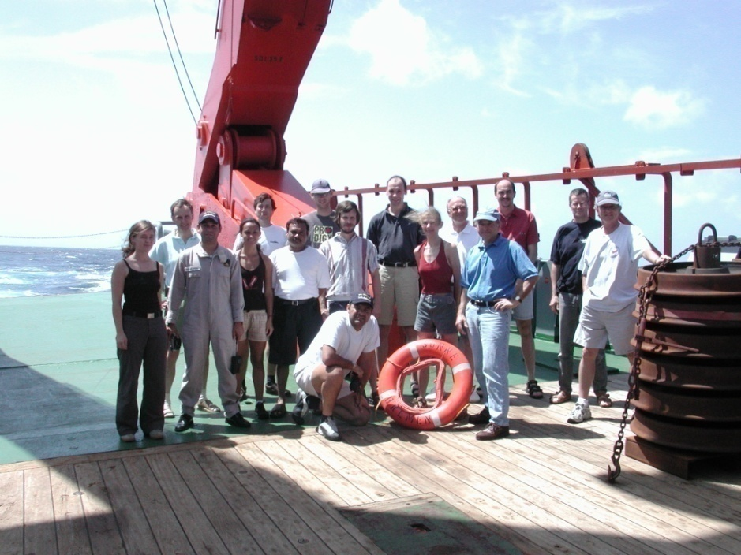
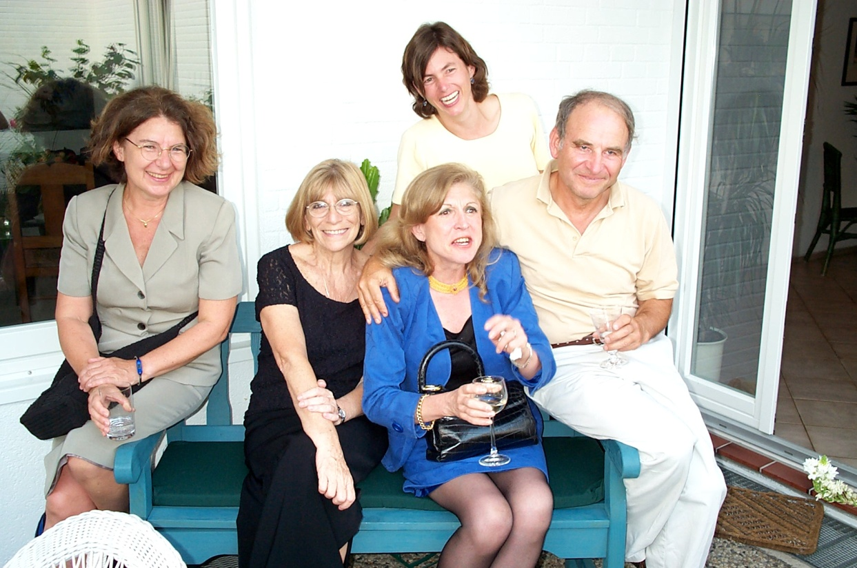
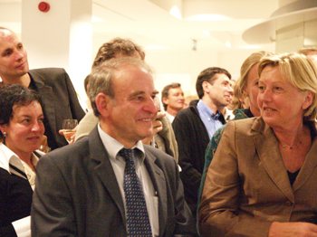
Notes:
At the end of this talk I selected a few pictures showing Fritz during the MIT Starr lecture, together with captain Kull from the research vessel Meteor, together with his scientific crew during one of his last cruises, at his home in Schilksee as well as during the CLIVAR Workshop on North Atlantic Thermohaline Circulation Variability in September 2004 together with his wife Inge.

Slide 11
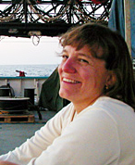
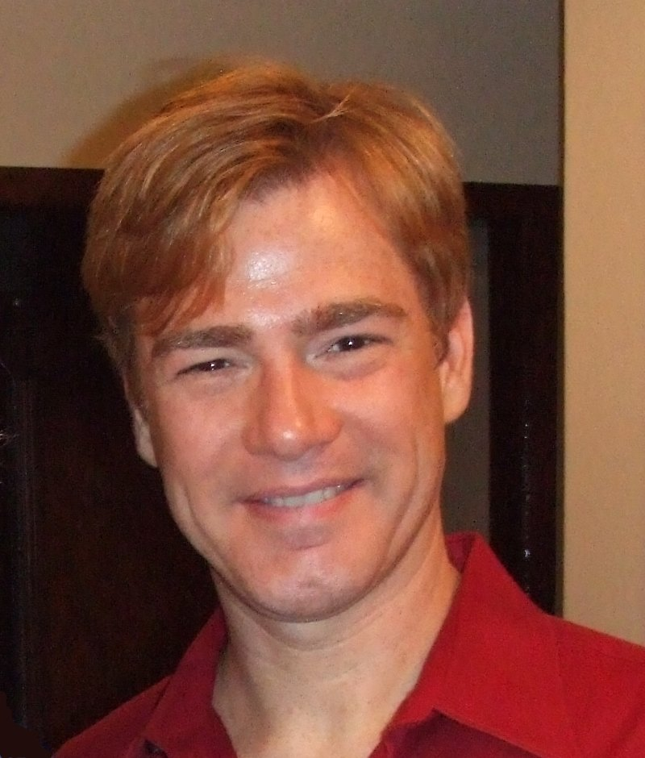
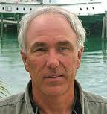
Previous Speaker
Amy Bower
WHOI
Woods Hole
Rick Lumpkin
NOAA/AOML
Miami
William E. Johns
RSMAS
Miami

Slide 12
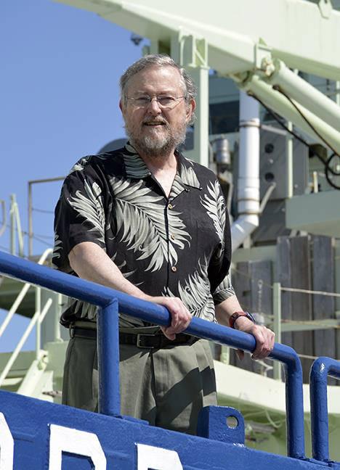
Moored observations of the Deep Western Boundary Current in the NW Atlantic: 2004-2014
Dr. John M. Toole
Woods Hole Oceanographic Institution
Woods Hole, MA, USA

Slide 13
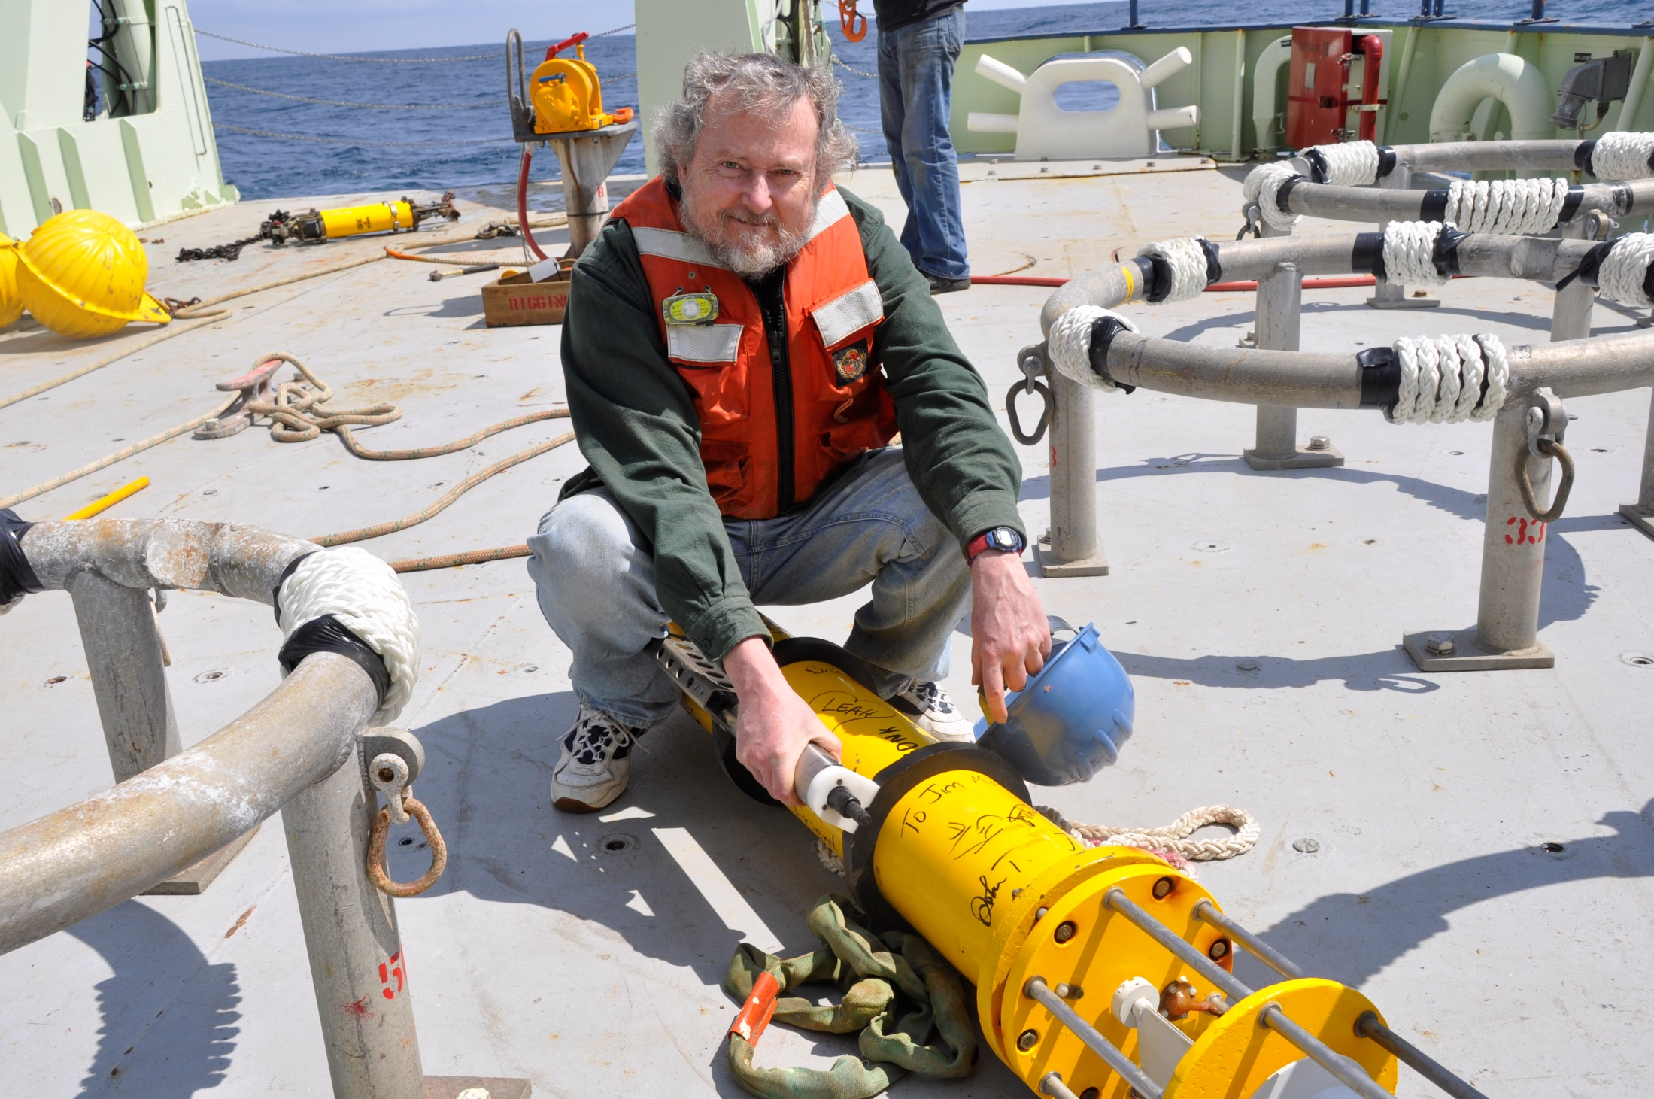
Meet the Prof.
Dr. John Toole Senior Scientist, Department of Physical Oceanography,
Woods Hole, USA
16 June 2016 | 09:30 h
Large conference room, GEOMAR
This is an open event for all interested participants from Bachelors students to Post-Docs.

Slide 14
Moored observations of the Deep Western Boundary Current in the NW Atlantic: 2004-2014
Dr. John M. Toole
Woods Hole Oceanographic Institution
Woods Hole, MA, USA

